Slide 1

Data Description
Session 2
M. Kachour

Slide 2
Exercise 1
We studied the morning temperature (i.e. measured between 7am and 7.30am) over 200 days chosen randomly from the winter periods observed over the last 20 years.
The data are represented in the following table:
Represent Graphically data
Plot the curve of increasing cumulative frequencies
Temperature | Number of days
-1 | 40
0 | 34
2 | 86
3 | 20
7 | 20

Slide 3
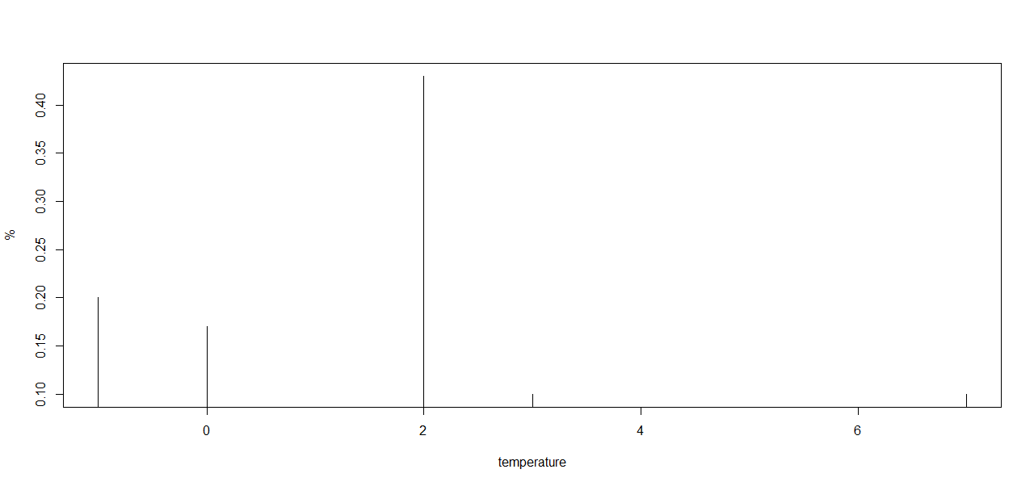
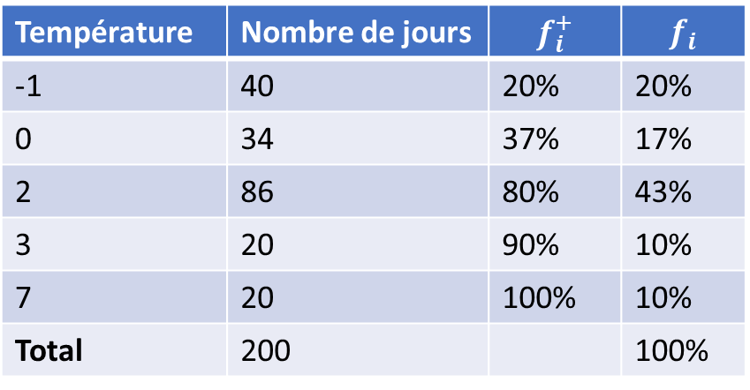
Exercise 1 - Solution
Temperature | Number of days | $$f_{i}^{+}$$ | $$f_{i}$$
-1 | 40 | 20% | 20%
0 | 34 | 37% | 17%
2 | 86 | 80% | 43%
3 | 20 | 90% | 10%
7 | 20 | 100% | 10%
Total | 200 |  | 100%

Slide 4
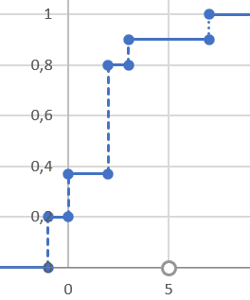
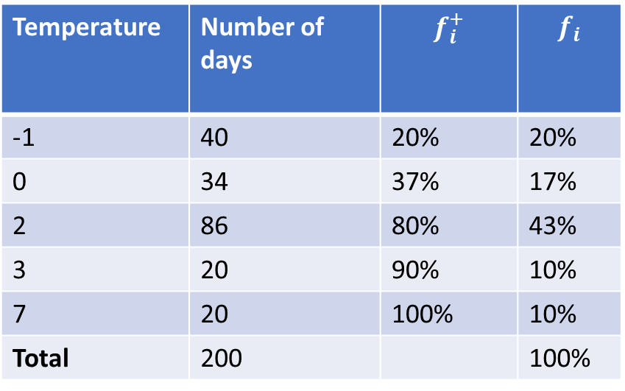
Exercise 1 - Solution
Temperature | Number of days | $$f_{i}^{+}$$ | $$f_{i}$$
-1 | 40 | 20% | 20%
0 | 34 | 37% | 17%
2 | 86 | 80% | 43%
3 | 20 | 90% | 10%
7 | 20 | 100% | 10%
Total | 200 |  | 100%

Slide 5
Exercise 2
We studied the morning speed (i.e. measured (in Km/h) between 7am and 7.30am) of the wind over 240 days chosen randomly from the winter periods observed over the last 20 years.
The data are represented in the following table:
Represent Graphically data
Plot the curve of increasing cumulative frequencies
Speed | Number of days
[0 ; 10[ | 42
[10 ; 30[ | 48
[30 ; 70[ | 90
[70 ; 100[ | 24
[100 ; 150[ | 36

Slide 6
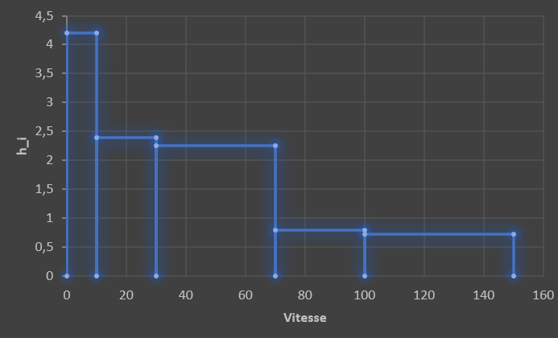
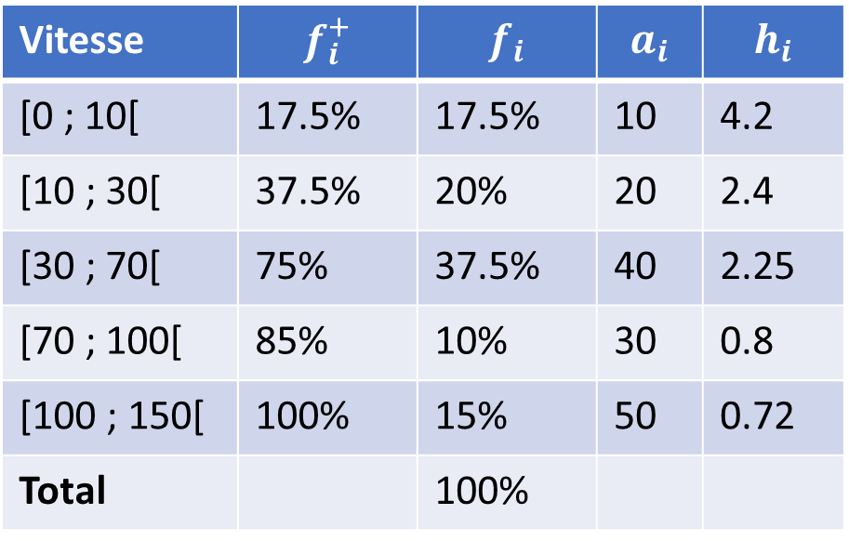
Exercise 2 - Solution
Vitesse | $$f_{i}^{+}$$ | $$f_{i}$$ | $$a_{i}$$ | $$h_{i}$$
[0 ; 10[ | 17.5% | 17.5% | 10 | 4.2
[10 ; 30[ | 37.5% | 20% | 20 | 2.4
[30 ; 70[ | 75% | 37.5% | 40 | 2.25
[70 ; 100[ | 85% | 10% | 30 | 0.8
[100 ; 150[ | 100% | 15% | 50 | 0.72
Total |  | 100%

Slide 7
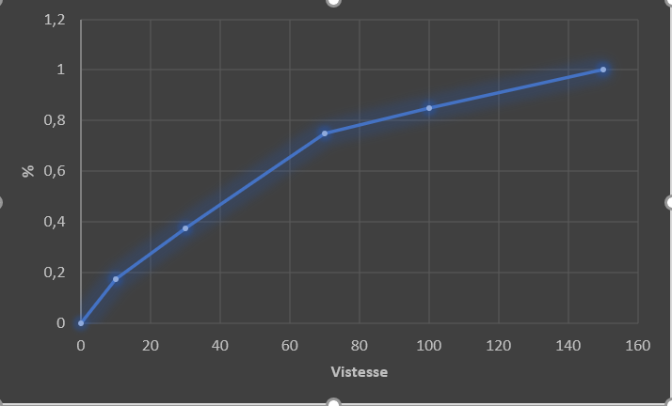

Exercise 2 - Solution
Vitesse | $$f_{i}^{+}$$ | $$f_{i}$$ | $$a_{i}$$ | $$h_{i}$$
[0 ; 10[ | 17.5% | 17.5% | 10 | 4.2
[10 ; 30[ | 37.5% | 20% | 20 | 2.4
[30 ; 70[ | 75% | 37.5% | 40 | 2.25
[70 ; 100[ | 85% | 10% | 30 | 0.8
[100 ; 150[ | 100% | 15% | 50 | 0.72
Total |  | 100%

